Slide 1
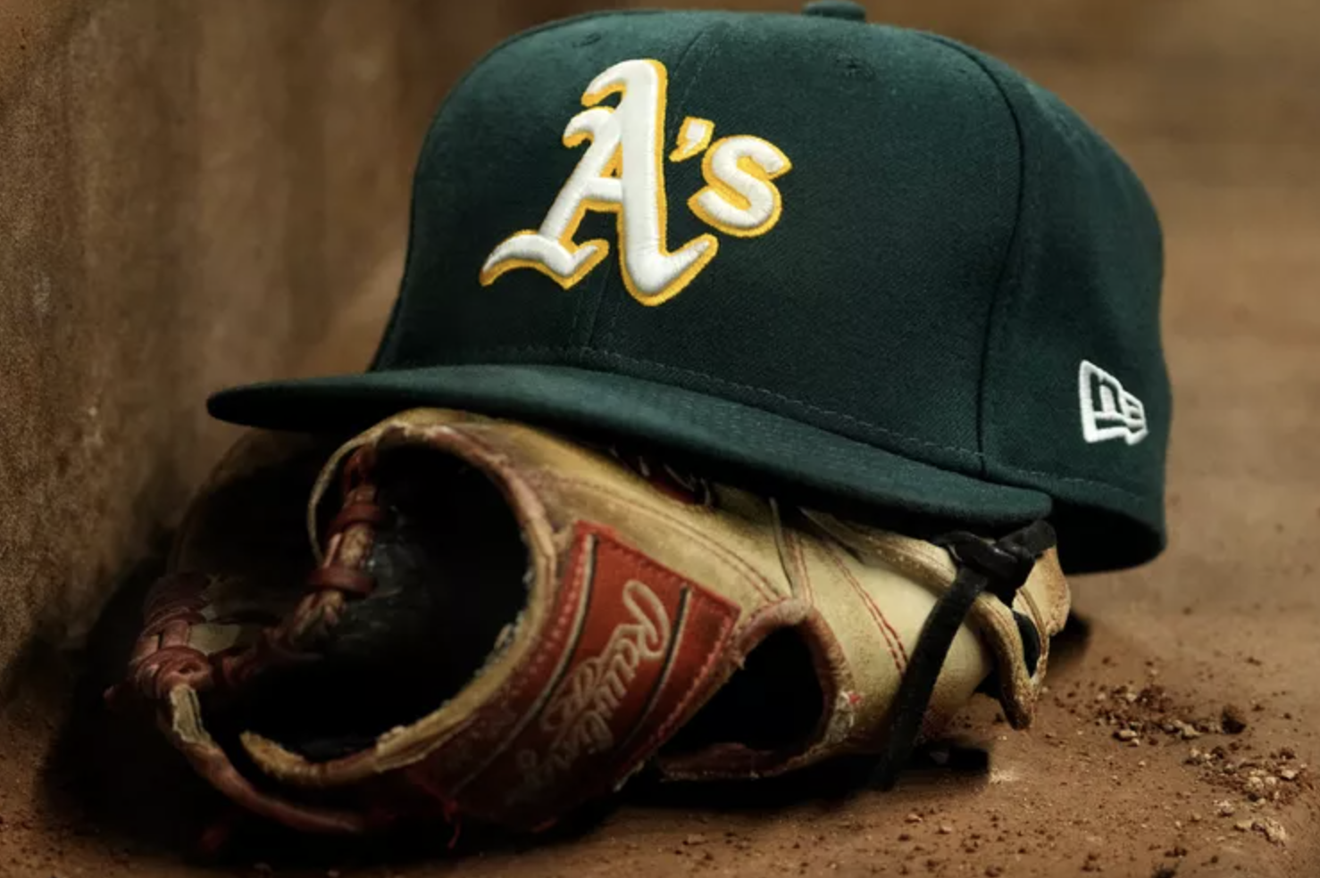

Money Ball - the application of Machine Learning in Baseball
By Miguel Ojeda

Slide 2
Agenda
Overview
Money Ball
Linear Regression
Exploring the Dataset
Analysis
Summary & Recommendations

Slide 3
Overview
“Sabermetrics” – developed by an economist named Bill James, is the empirical analysis of baseball through statistics.
“Moneyball” – adapted from Sabermetrics became a strategy for building competitive sports teams using advanced statistical analysis to identify undervalued players.
In 2002 the Oakland A’s, lead by GM Billy Beane and Assistant GM Paul DePodesta, utilized Sabermetrics to produce a high-performing team with the one of the smallest budgets in the league.
My goal is to predict the outcome of a team's performance by utilizing the approach developed by Billy Beane and Paul DePodesta.

Slide 4
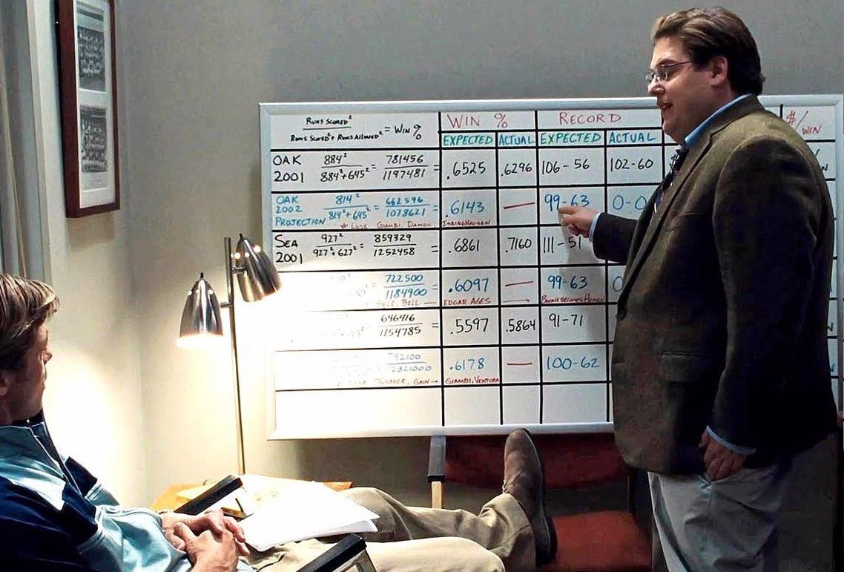
Money Ball - Metrics
Paul DePodesta used the following metrics to determine Winning Key Performing Indicators:
Runs allowed (RA)
Runs scored (RS)
On Base Percentage (OBP)
Opponent’s OBP (OOBP)
Slugging Percentage (SLG)
Opponent’s SLG (OSLG)
Batting Average (BA)
Source: MoneyBall (Motion Picture) 2011

Slide 5
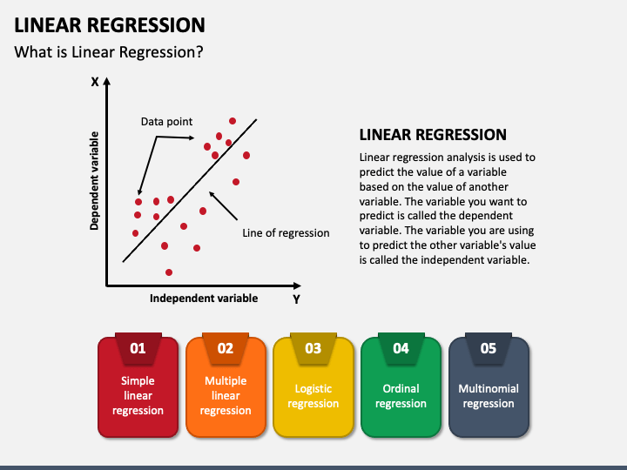
Linear Regression
Regression is a statistical technique used to determine the relationship between a dependent variable and one or more independent variables, often for prediction or forecasting purposes.
Linear Regression is a Supervised Machine Learning Algorithm which takes the statistical approach further
This analysis will use more than one Regression Approach
Source: SketchBubble - https://www.sketchbubble.com/en/presentation-linear-regression.html

Slide 6
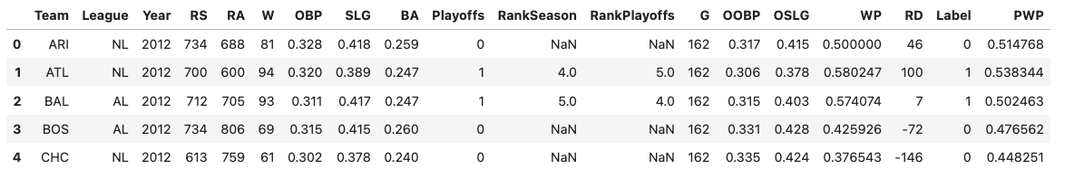
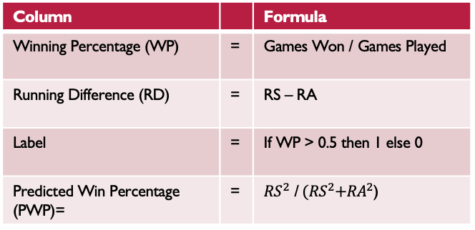
Exploring the Dataset ‘MoneyBall’
Provided by Kaggle this a high-level dataset that captures each team’s seasonal performance in the MLB ranging from 1962 to 2012
4 metrics that Paul DePodesta used have been created for this analysis →
Column |  | Formula
Winning Percentage (WP) | = | Games Won / Games Played
Running Difference (RD) | = | RS – RA
Label | = | If WP > 0.5 then 1 else 0
Predicted Win Percentage (PWP)= | = | ${RS}^{2}$ /${ (RS}^{2}+{RA}^{2}$)

Slide 7
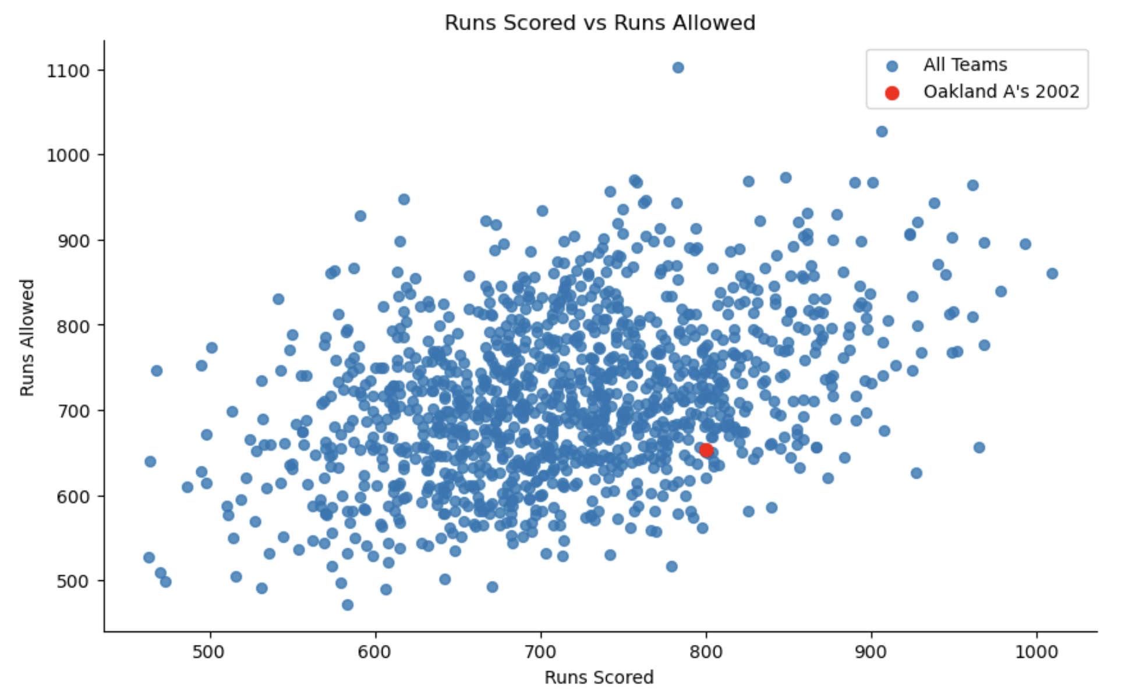
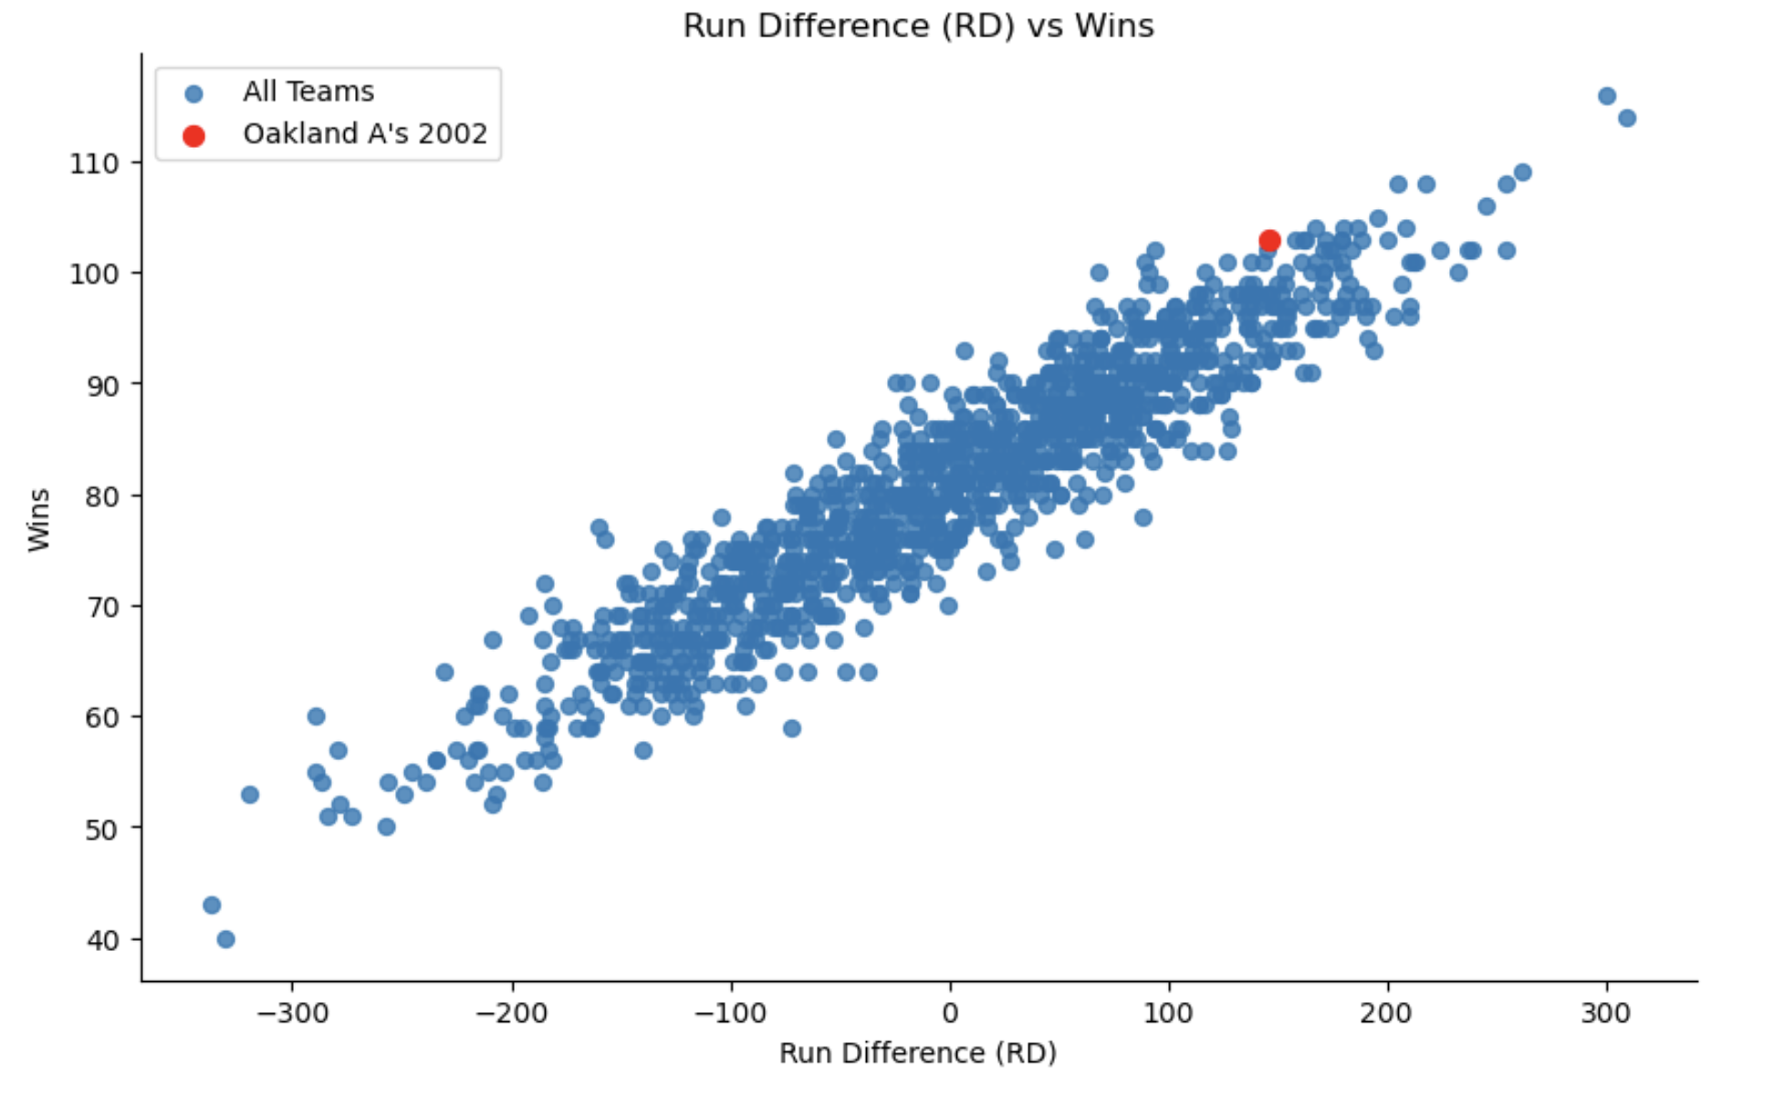
Analysis – Part 1
First step: I wanted to compare the relationship between Runs Allowed (RA) and Runs Scored (RS)
The chart below shows that there is a somewhat relationship
Paul DePodesta relied heavily upon RD to predict
The chart below shows that as RD increases so does the wins

Slide 8
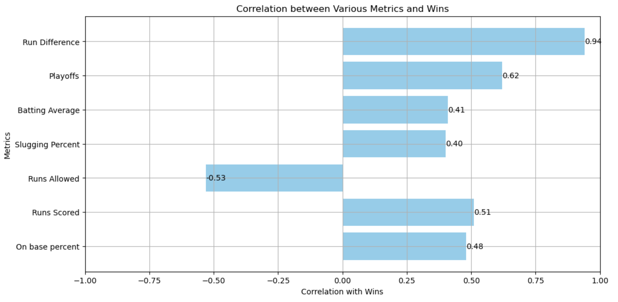
Analysis – Part 2
Not wanting to place a bias on RD I wanted to test correlation among the other metrics.
The chart to the right shows that RD still holds the highest correlation to a Team’s Game Win

Slide 9
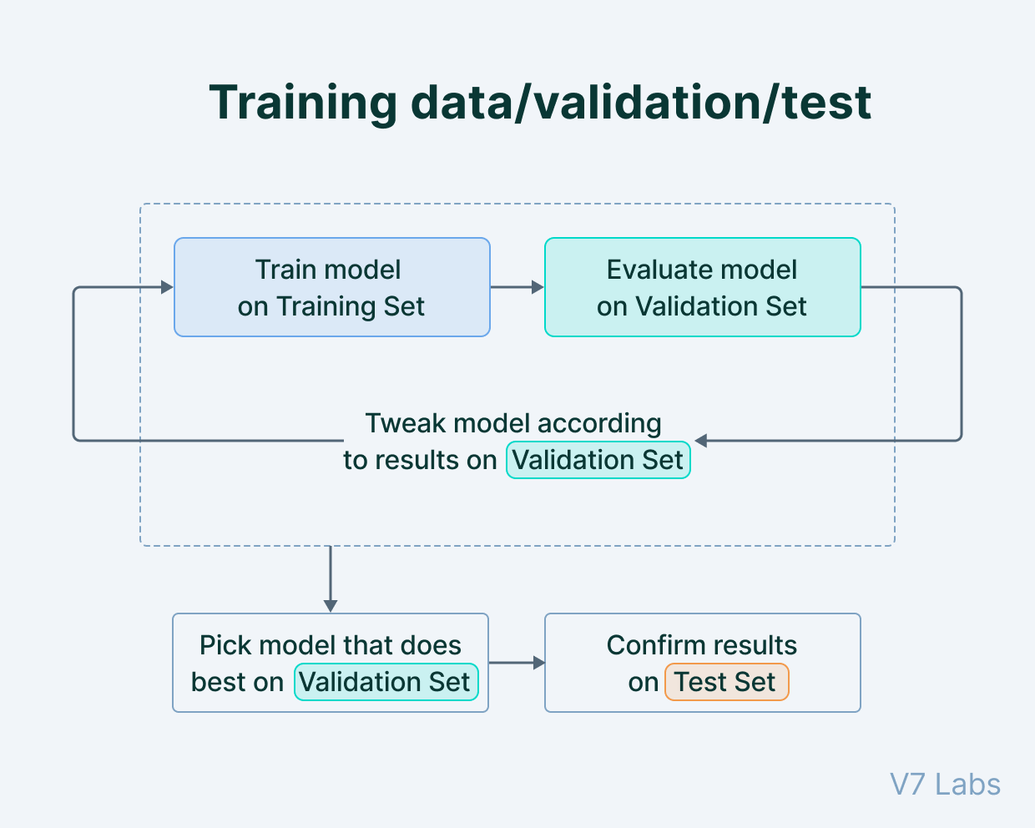
Analysis – Part 3
Next, I needed to take the dataset and split it into training and testing groups.
The training data is used to train each model and then we compare our predictions against the test data.
My training set is filtered before the 2002 season and the testing data is anything after
As mentioned earlier, I decided to use a variety of regressions and classification models to predict the out-come of the the Oakland A’s

Slide 10
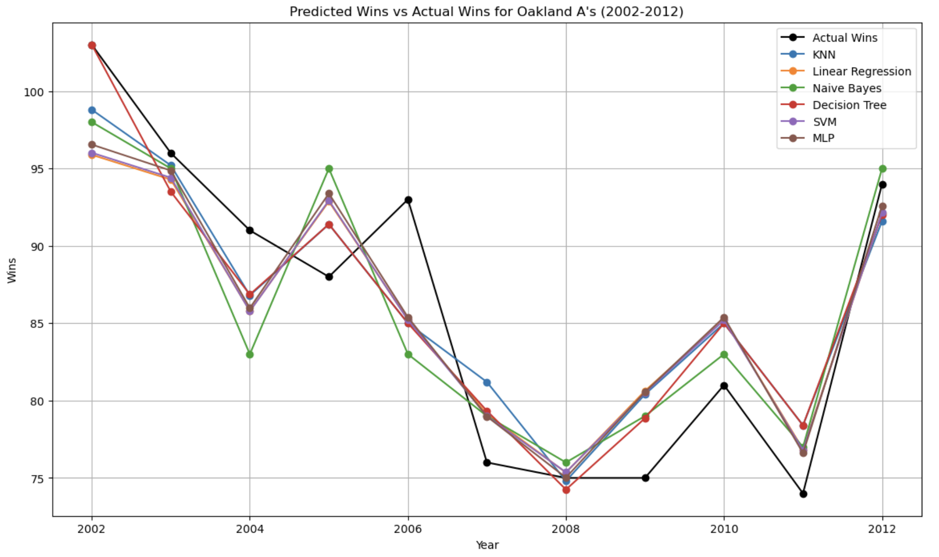
Analysis – Part 4
The chart to the right is a visual of each models predicted Win vs the Actual Wins for the Oakland A’s by season.
Each model is accurate for some seasons but not consistently for all

Slide 11
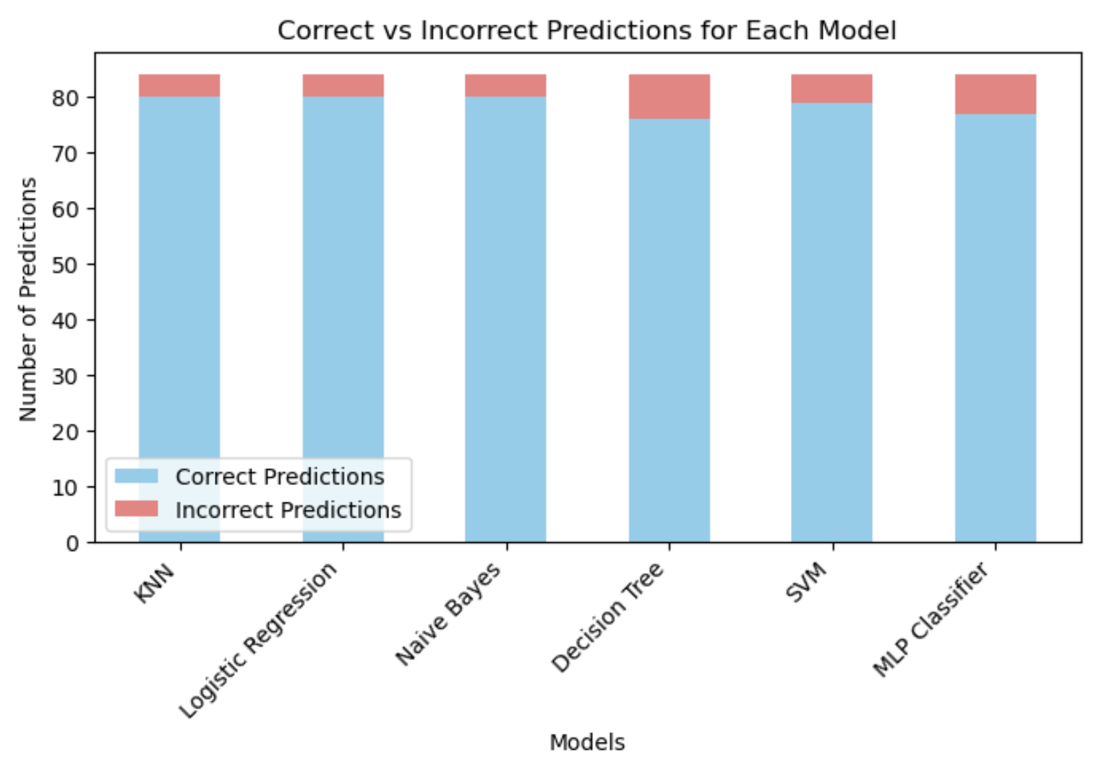
Analysis – Part 5
The strength of each model can be seen in the image to the right.
KNN and Logistic Regression seemed to be most consistently accurate models.

Slide 12
Summary & Recommendations
The data is retrospective and very high-level.
The remaining take still contains a look-back bias where you would only know the "Runs Score" after a season has completed.
Due to this, our models can learn very well the patterns of a successful season and can predict accurately if a season has a positive win record.
It is interesting that all the models seem to converge at the same 95.24% accuracy. This is suggesting some variability in performance.
Billy Beane and Paul DePodesta had a much more granular view of each game and could refine their models as the season continued.
I would recommend exploring a more detailed dataset but would still continue with the current models.

